Slide 1
Excel Data Visualization: Conditional Formatting
2024

Slide 2
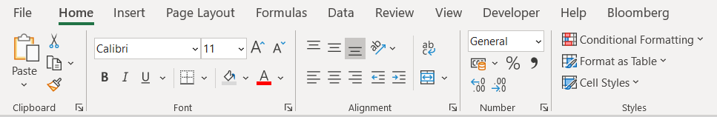
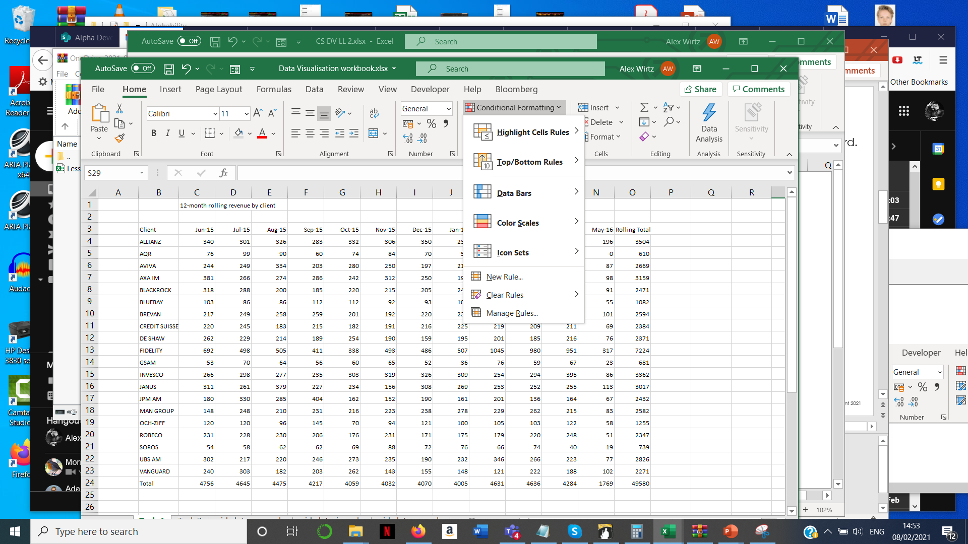
The conditional formatting wizard
1
Select the Home tab.
2
Select the Conditional Formatting Wizard.
3
Choose a rule from the rules wizard.

Slide 3
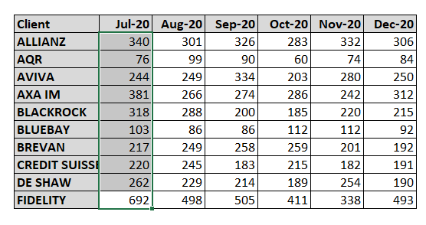
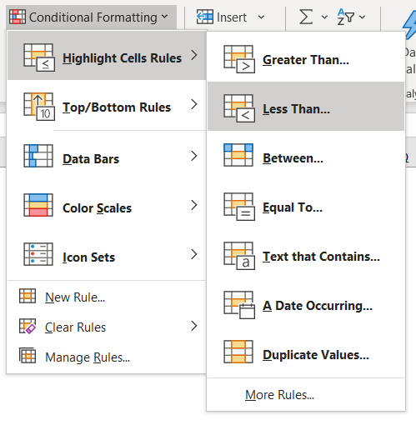
AN example
Your manager has a table of client revenue by month. They need to flag when clients deliver less than 100k of monthly revenue. Highlight these values.
1
Select the data range.
2
Select the formatting rule.

Slide 4
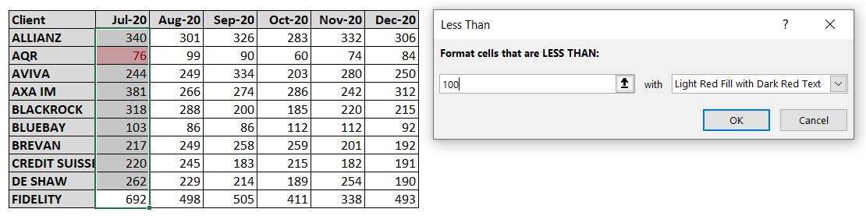
AN example
Your manager has a table of client revenue by month. They need to flag when clients deliver less than 100k of monthly revenue. Highlight these values.
3
Update the parameters in the wizard. You will see the rule applied in real time.

Slide 5
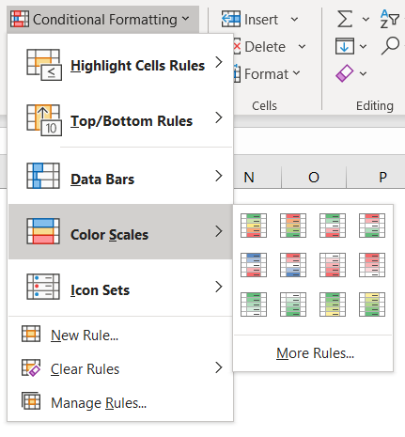
Focus on heatmaps
Heatmaps are excellent at highlighting outliers in data. But they need to be used with care.
1
Choose the Colour Scales option.
2
Choose a colour spectrum from the menu.

Slide 6
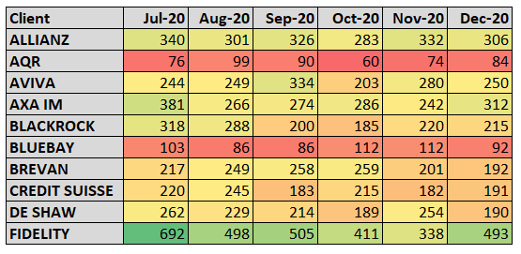
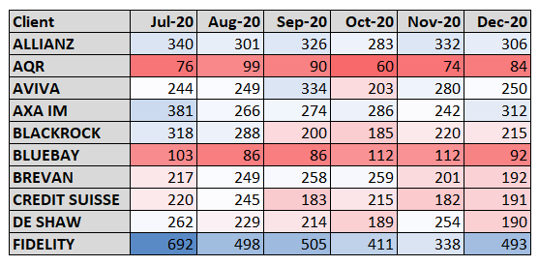
Focus on heatmaps
Which heatmap is better?
1
Green – yellow – red
2
Blue – white – red
Notes:
Definitely 2. The heatmap should foreground the outliers, not the middle-of-the-road values (which is what the yellow is doing in the first). Also, green/red differentiation is a problem for a significant proportion of users (approx. 8% men; 0.5% women). Newer GUI design takes this on board. Just don’t tell Bloomberg.

Slide 7
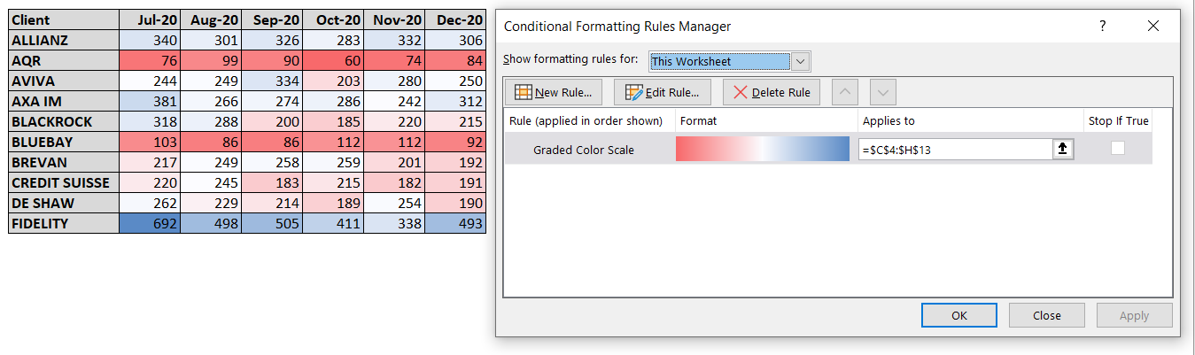
Managing formatting RULES
Changing, deleting, and other operations
1
Select the Manage Rules… menu item
2
Show the rules for your preferred scope

Slide 8
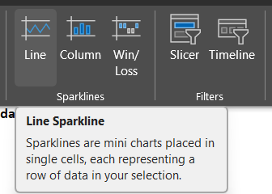
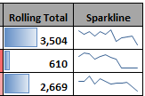
Sparklines AND MORE
Adding small visual representations to tabular data gives it greater impact without having to generate charts.
You can find the Sparklines option under the Insert tab on your ribbon.
This generates a small line chart of the data you have selected which can be added to the end of a row to summarise a trend.
Columns are a bar chart that can lie behind summary numbers.

Slide 9

EXERCISE
Please complete the Exercise in the spreadsheet that accompanies this Module.

